Slide 1
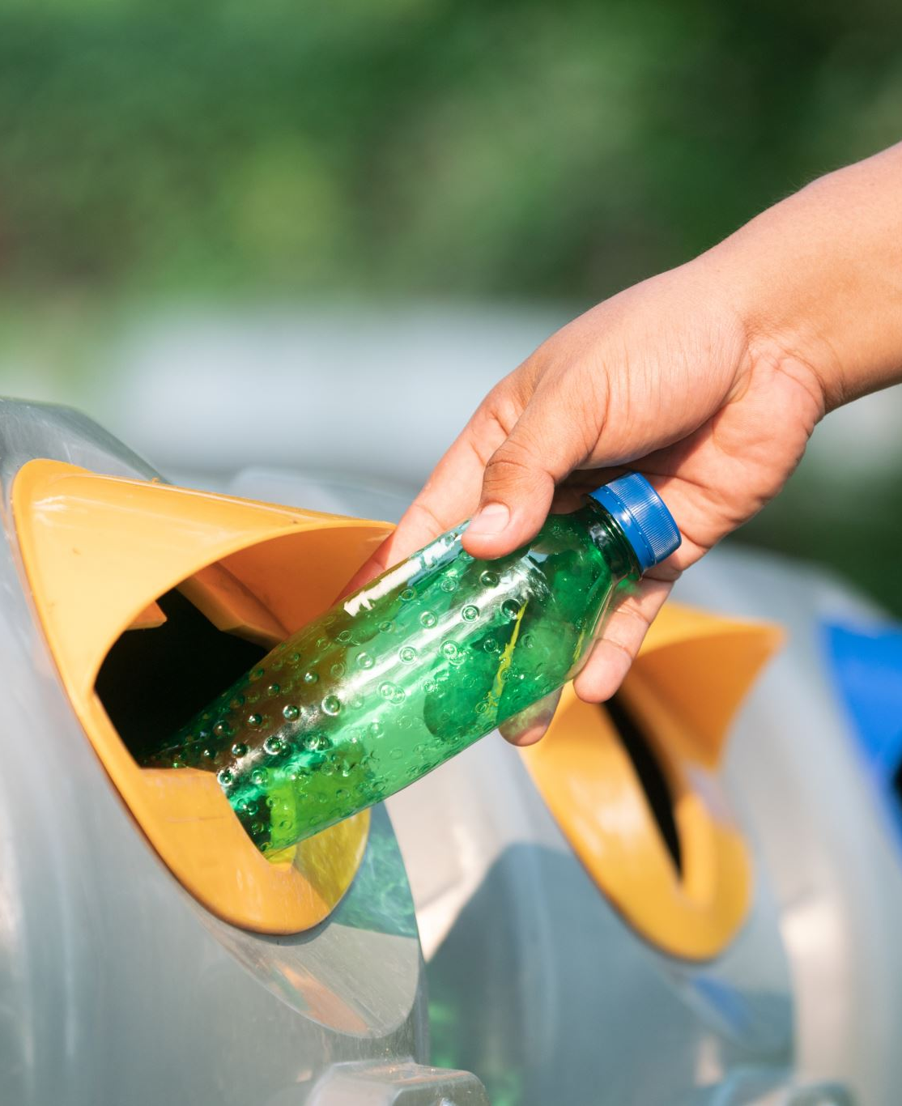
Smart Waste Management System

Slide 2

Team Details
S.No | Names | Roll No
1 | K .Hema Charan reddy | 2310030419
2 | Udit Raj Kumar | 2310030232
3 | M .Nihar Reddy | 2310030441
4 | K .Dheeraj | 2310030444

Slide 3
Overview
Our Smart Waste Management System offers a user-friendly application accessible to everyone. It is designed to streamline waste management processes by categorizing users into three roles:
Administrator: Manages system operations, monitors complaints, and oversees overall functionality.
User (Public): Reports waste-related complaints, such as overflowing bins or uncollected garbage, through the app.
Driver: Receives real-time notifications about complaints, navigates to the specified location, resolves issues, and updates the status in the app.
This system ensures efficient communication between users and service providers, enabling timely waste collection and problem resolution, ultimately contributing to cleaner and healthier environments.

Slide 4
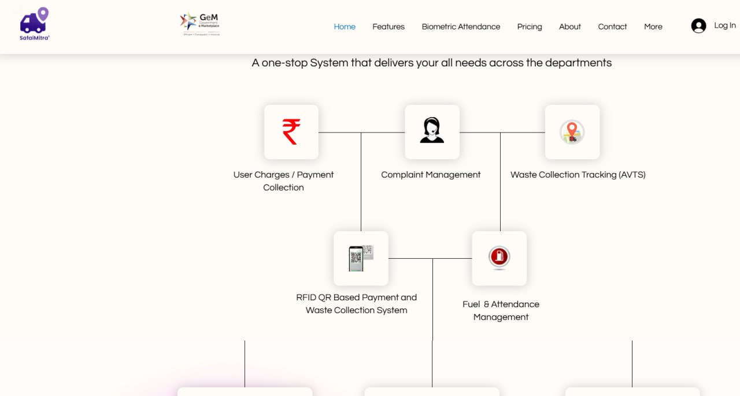
Overview of Existing Solution
No real-time monitoring or feedback system, causing delays in issue resolution.
IoT-enabled apps monitor waste levels in bins but charge high service fees for advanced features.
Apps allow users to report complaints but often involve subscription charges for complete functionality.
Limited real-time coordination between users, administrators, and drivers.
Like SafaiMitra

Slide 5
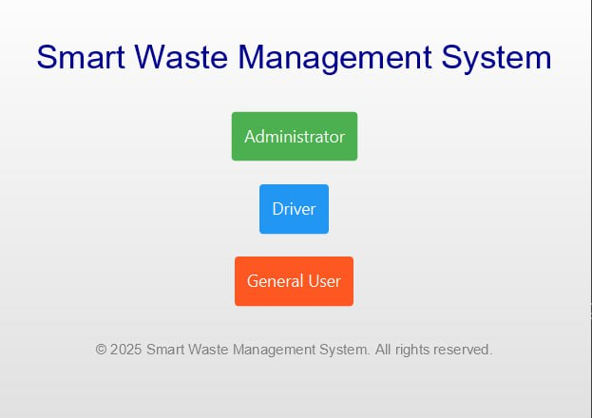
How it Is Different From Existing
Simplified interface, making it easy for users (public) to report complaints and track status.
Tailored for public use, addressing everyday waste management issues in local communities efficiently.
Drivers are notified instantly about complaints, enabling quick action and timely problem resolution.
Provides live updates on complaint status, ensuring transparency for all stakeholders.

Slide 6
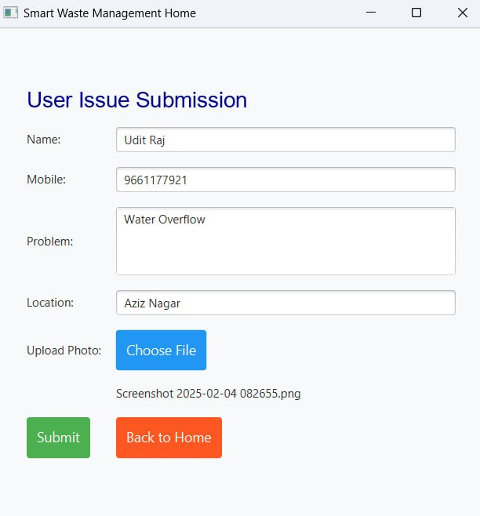
How it Is Different From Existing
Completely free to use, ensuring all features are available to everyone without any recurring costs.
Free usage encourages higher participation from the public, leading to faster problem resolution and cleaner communities.

Slide 7
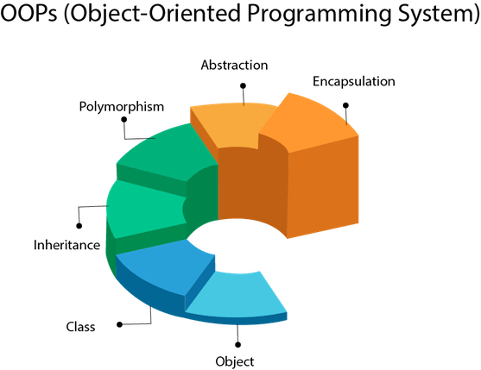
Programming Language and OOP Principles Used
Advanced Java (JavaFX) is used for developing the Smart Waste Management System.
Encapsulation: Data and methods are bundled into classes like User, Administrator, and Driver to protect sensitive information and maintain modularity.
Inheritance: Common attributes and methods are inherited from base classes, such as a Person class, to reduce redundancy.
Polymorphism: Enables dynamic behavior, such as displaying role-specific functionalities (e.g., user vs. driver actions).
Abstraction: Abstract classes and interfaces define the core functionalities (e.g., complaint handling) while hiding unnecessary implementation details.

Slide 8

Software and Tools
Database:
Currently using local storage for temporary data handling.
Planning to migrate to MongoDB, a NoSQL database, for scalable and efficient data storage and management.
Framework : JavaFX is used for building the front-end interface, offering interactive and user-friendly features.
IDE : IntelliJ IDEA is used for development, providing advanced coding, debugging, and deployment tools for efficient programming.
Future Integration:
MongoDB Atlas for cloud-based database management to enable global accessibility and data security.

Slide 9
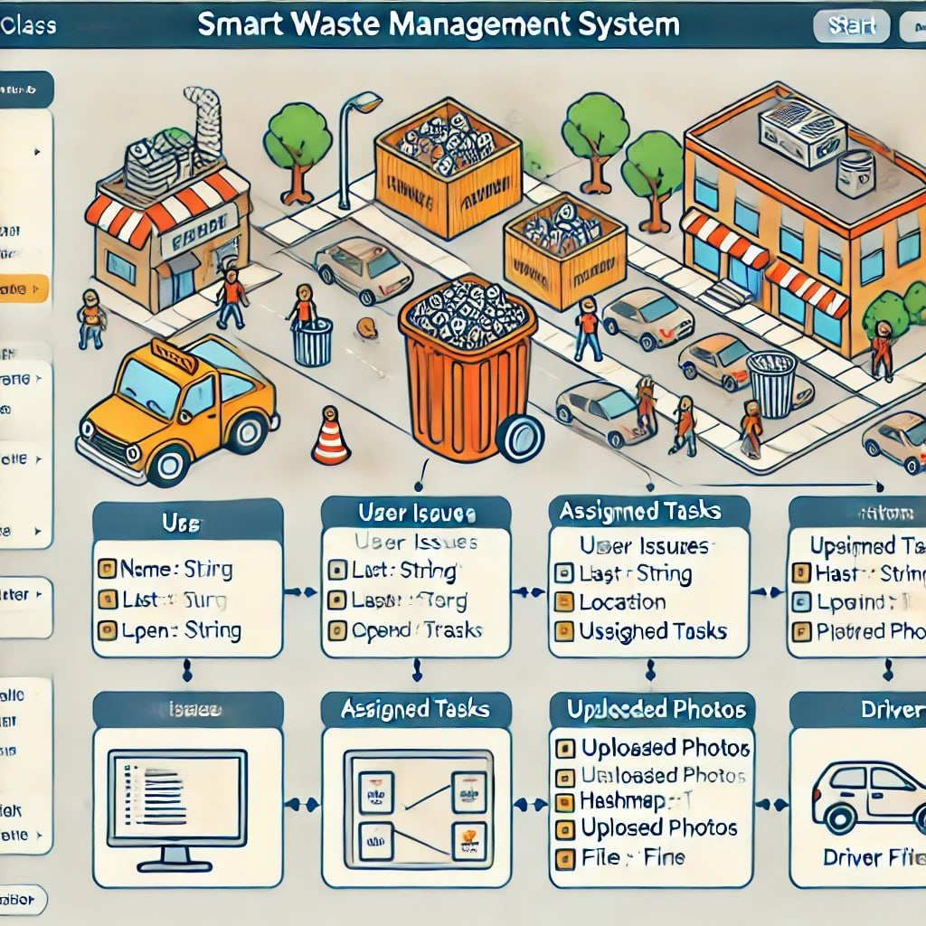
Class Diagram

Slide 10
Architectural Style
Presentation Layer: JavaFX GUI components for interaction (e.g., user form, admin dashboard, driver dashboard).
Application Layer: Handles business logic like issue tracking, task assignments, and proof uploads.
Data Layer: Uses in-memory data structures (List, HashMap) to store issues, tasks, and photos.

Slide 11
Conclusion
The Smart Waste Management System is a comprehensive solution aimed at revolutionizing waste management through automation, efficiency, and user engagement.
This project not only streamlines the waste collection process but also empowers users and authorities to collaborate effectively for cleaner and more sustainable environments.
The Smart Waste Management System provides an innovative and sustainable approach to waste management, promoting environmental responsibility and enhancing community well-being

Slide 12


Thank You!!!!

